Slide 1

Cancer immunotherapy based on the synergy of ligands of signaling and phagocytic receptors
Jan Ženka
Faculty of Science, University of South Bohemia in České Budějovice

Slide 3
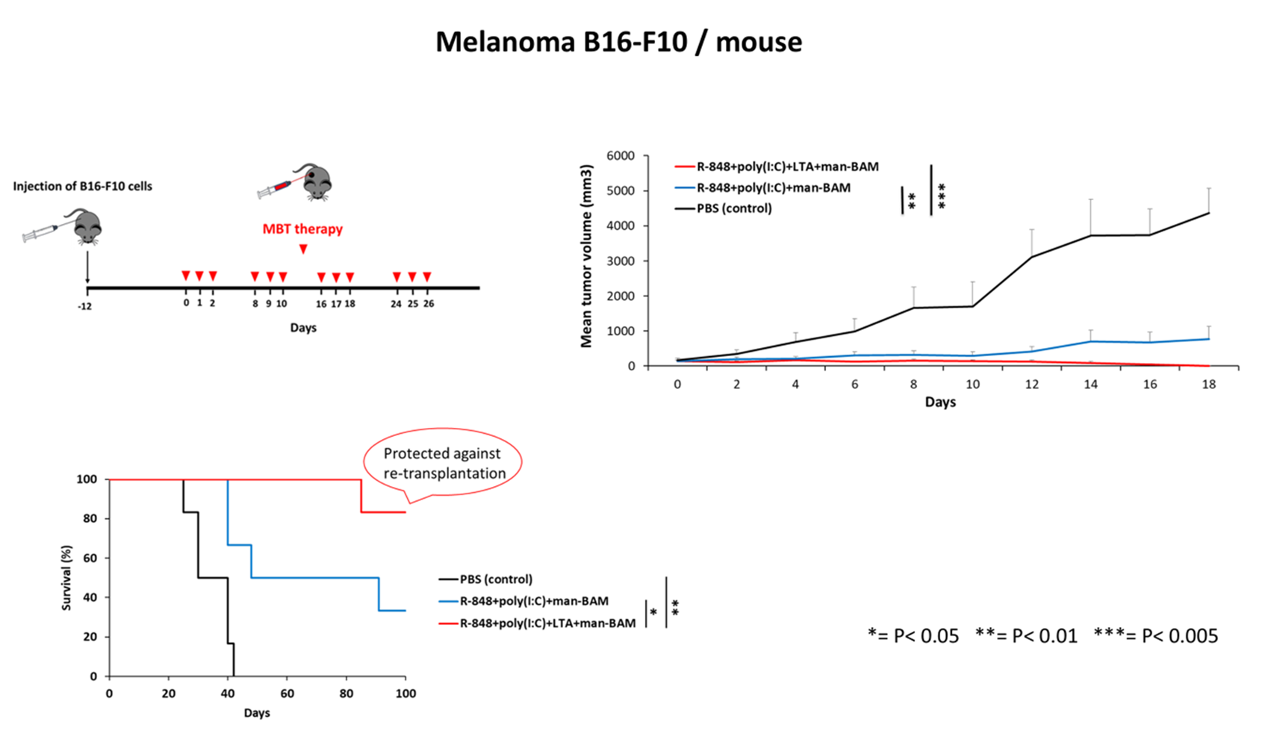

Slide 4
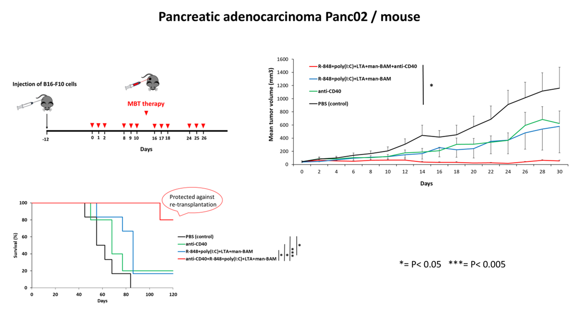

Slide 5
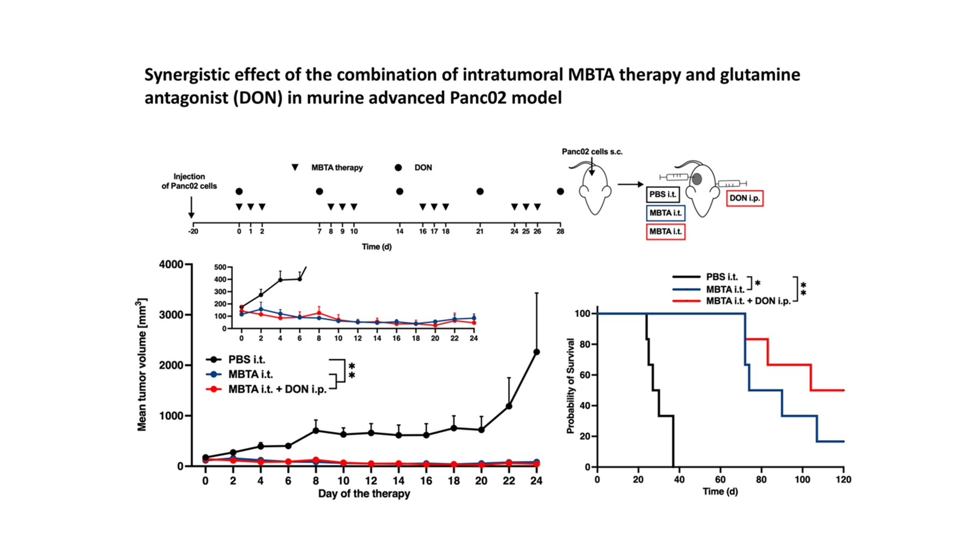

Slide 6
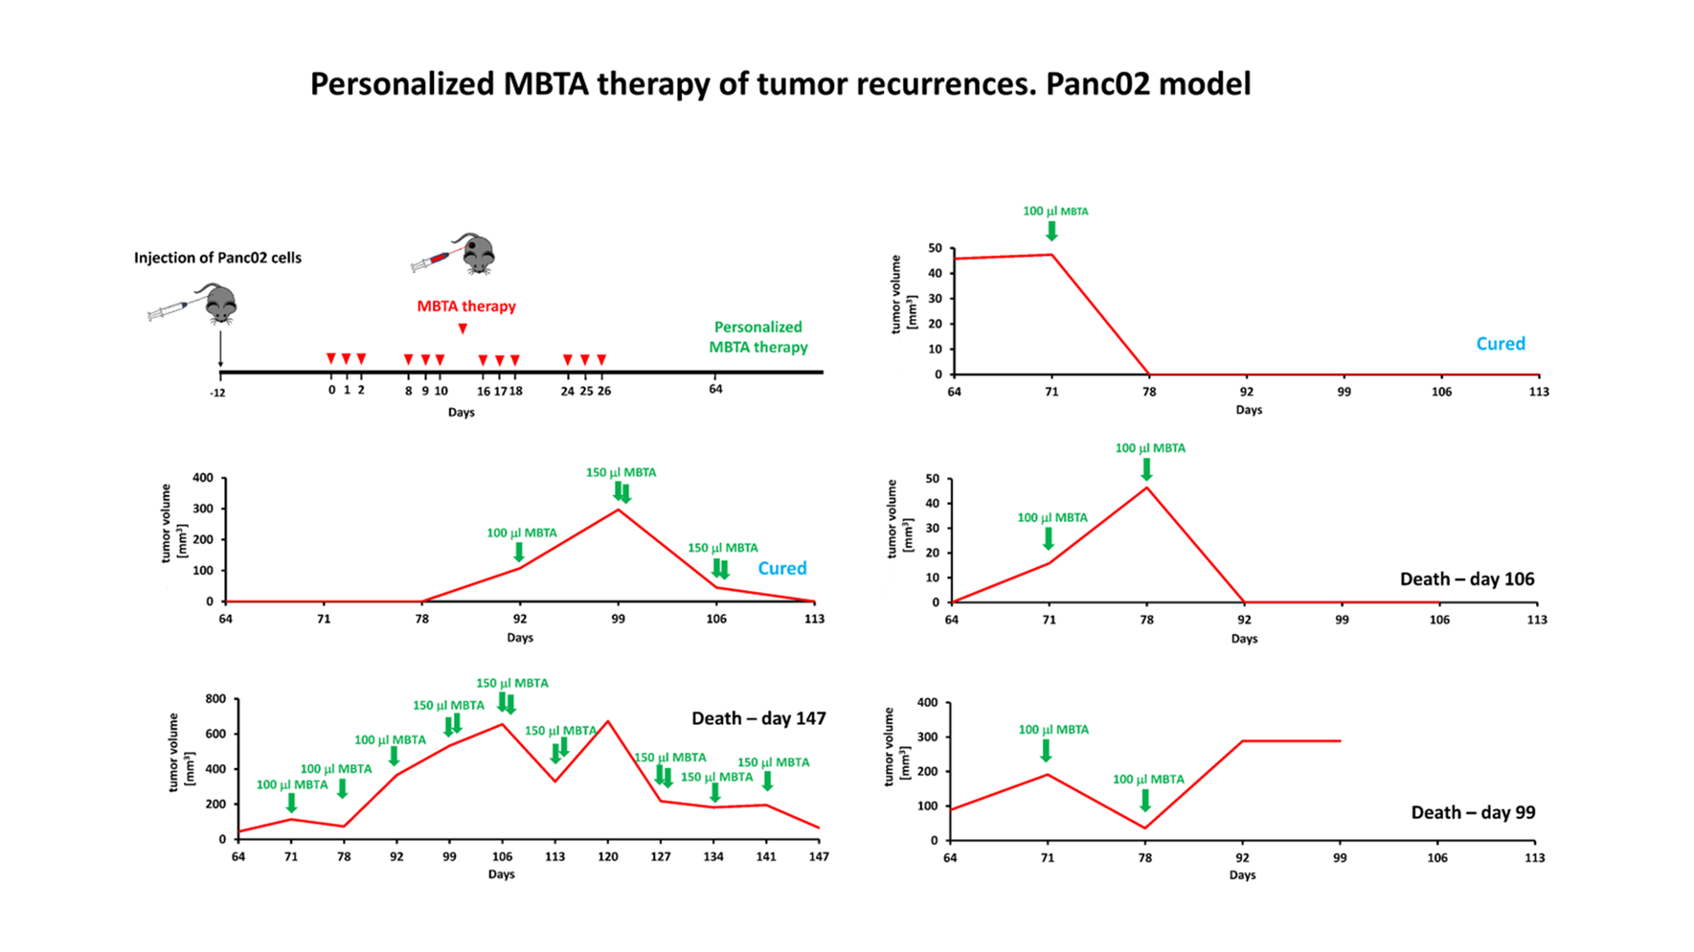

Slide 7
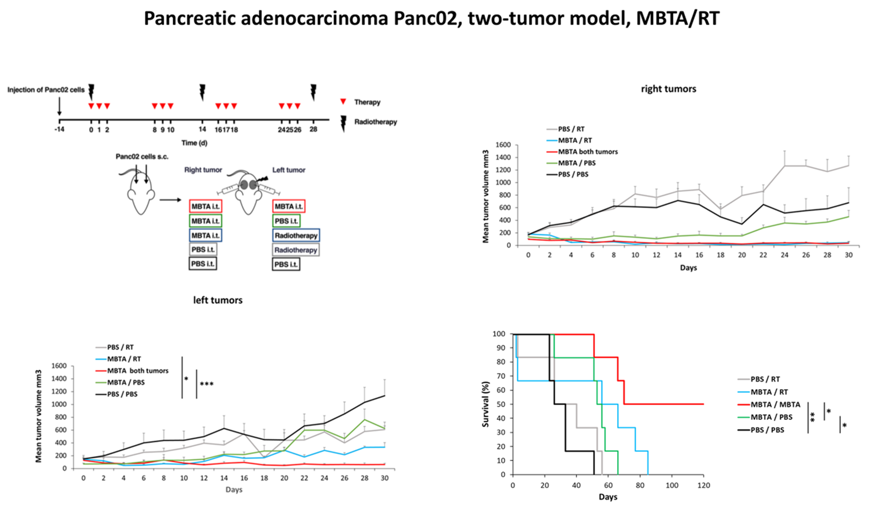

Slide 8
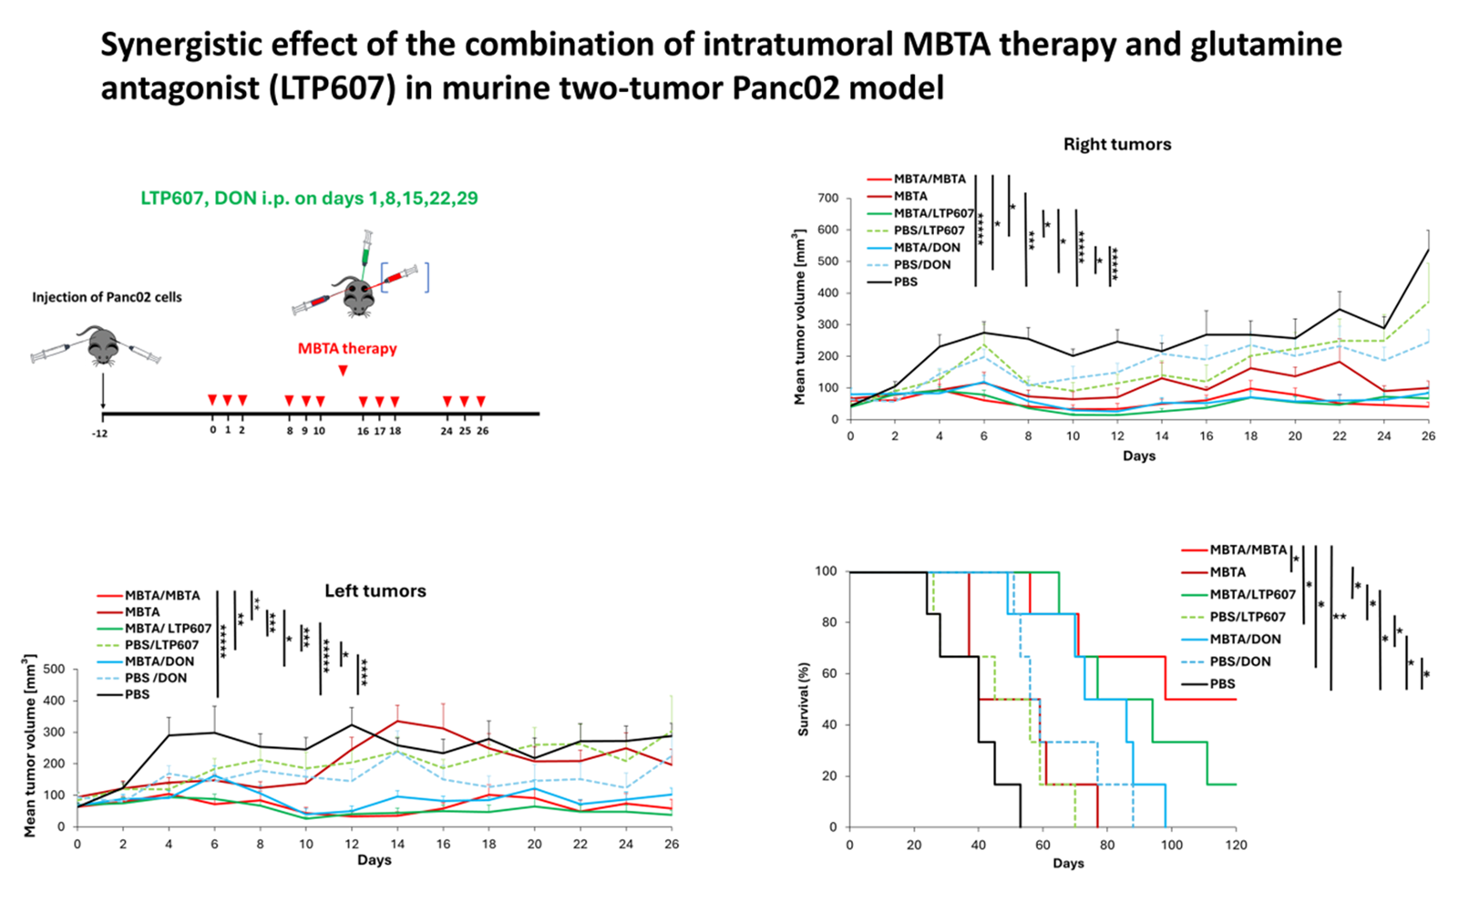

Slide 9
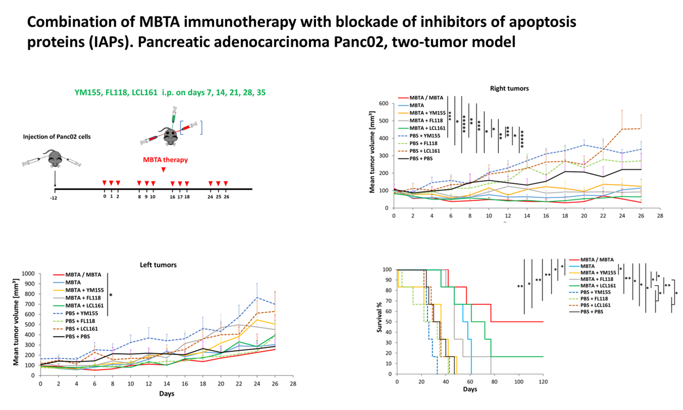

Slide 10
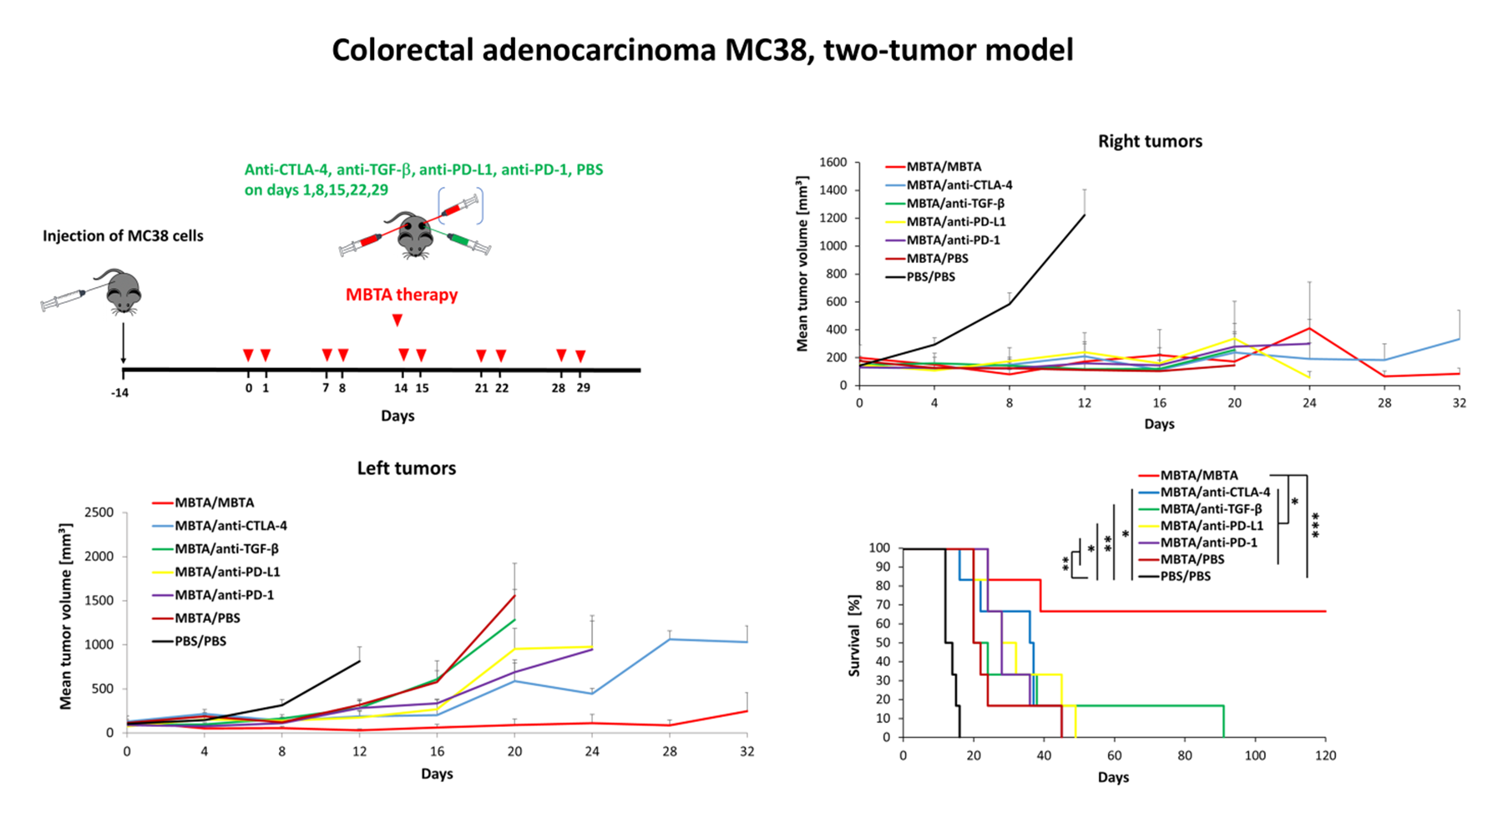

Slide 11
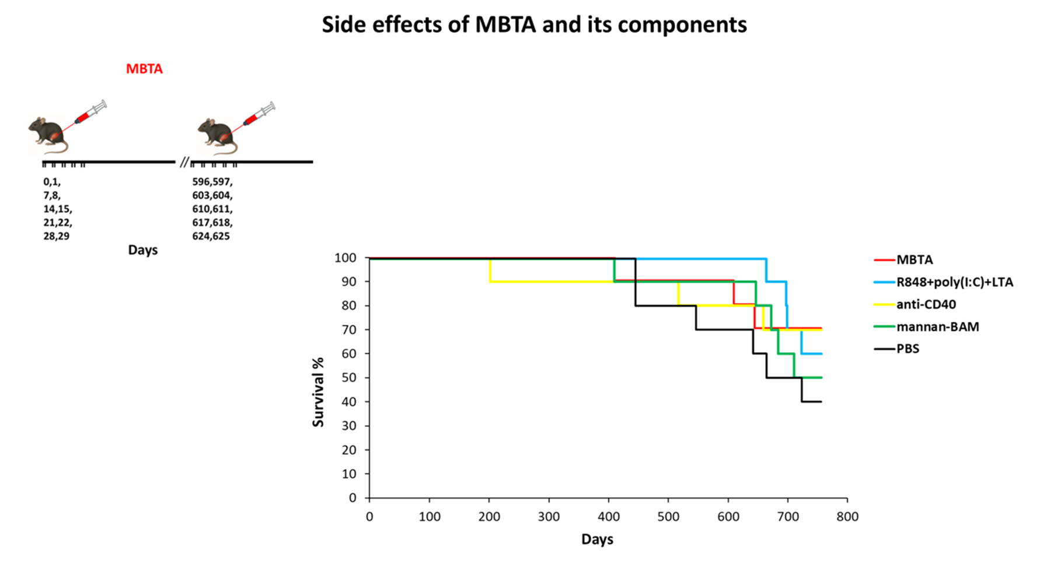

Slide 12
Models on which MBTA immunotherapy has been successfully tested
melanoma B16-F10
pancreatic adenocarcinoma Panc02
sarcoma S-180
colorectal carcinoma MC38
pheochromocytoma MTT
colorectal carcinoma CT-26
breast carcinoma 4T1
glioma GL 261
University of South Bohemia
NIH

Slide 13

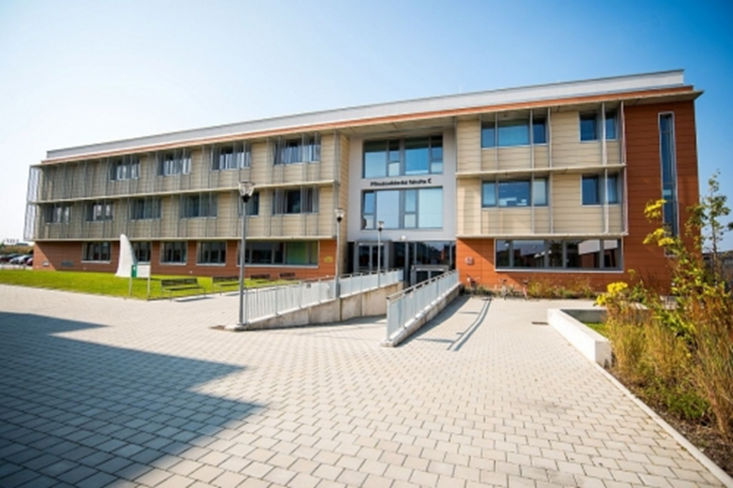
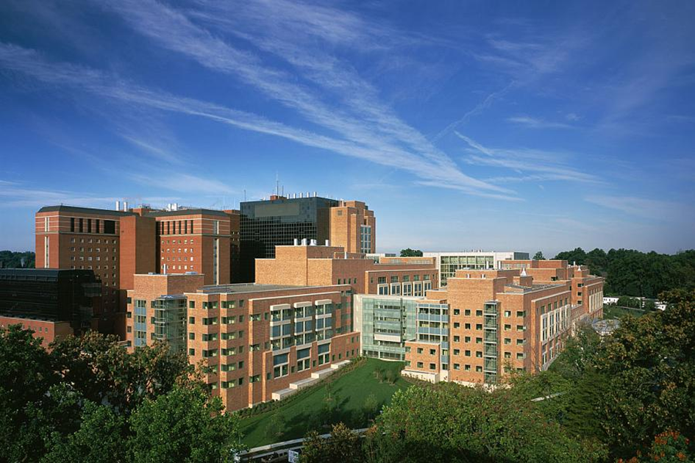
National Institutes of Health (NIH), Bethesda, USA
Veronika Caisová, Ondřej Uher, Radka Lencová, Andrea Frejlachová, Markéta Skaličková, Anna Venhauerová, Aneta Havlová
Laboratory of Professor Pacák and Professor Zhuang
Research Support Foundation, Vaduz, Fürstentum Liechtenstein; BioCanim a.s. Praha; Intramural Research Program of the National Institutes of Health, Eunice Kennedy Shriver National Institute of Child Health and Human Development; Liga proti rakovině, Praha; Cancer Immunotherapy Endowment Fund, České Budějovice

Slide 14
Thank you for your attention

